Slide 1

Usage Of Bikes in Cyclistic Bike-Share (Members vs Casual Riders)
Presented by: Aqil Rashid Khan

Slide 2
Objectives
Compare how usage of bikes differ between members and casual users.
Answer how and why to market membership to current casual riders.

Slide 3
Data Sources
Data used for this project is from January 2021 to December 2021, a period of 12 months.
Data was obtained directly from company records available at https://divvy-tripdata.s3.amazonaws.com/index.html.
License to use data is available at https://www.divvybikes.com/data-license-agreement.

Slide 4
Data Cleaning Process
Data was cleaned in accordance with rules found at https://www.divvybikes.com/system-data.
Data was cleaned in Excel spreadsheet .
Large volume of data was combined and transformed using power query.
Cleaning measures included removing empty rows, missing value rows and other data formatting.
Rides where start time & end time are same were removed . Also, rides where start time is greater than end time, where removed.
Rides with minimum duration of 1 minute were considered.
Rides trips that were simply docked for multiple days were removed.

Slide 5
Data Manipulation Process
Cleaned data was organized by rider type (member or casual), day of the week.
Added ride length, day of the week and overall usage of bikes.
Ride duration was obtained from the difference between the start and end times. This duration was converted to get ride length in minutes.
Overall usage of bikes was calculated by multiplying average ride length in hours and number of rides.

Slide 6
Data Analysis Process
Before Analysis, We should know the difference between Member Riders and Casual Riders.
Members Riders have an Annual pass or subscription. They use the bikes regularly.
Casual Riders either have a single ride pass or a full day pass and are charged accordingly.

Slide 7
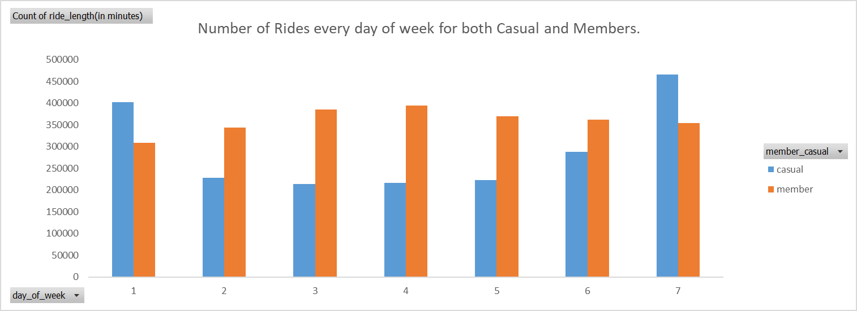
Number of Rides (Every day of week)
Number of Rides for weekend days is high for casual riders than member riders.
Member Riders use Cyclistic bikes for weekdays maybe to commute from work to office and back.

Slide 8
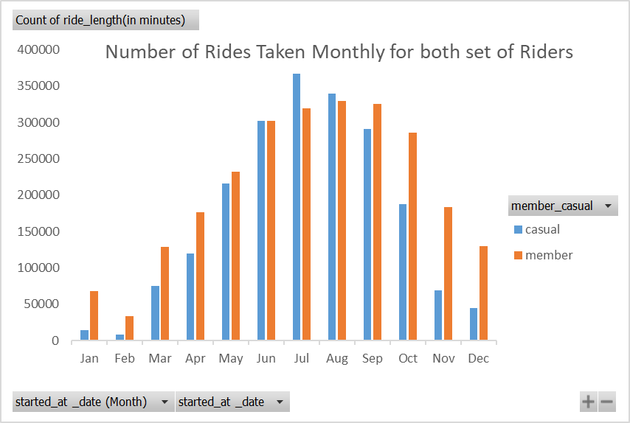
Number of Rides for both set of Riders on Monthly Basis
Casual Riders take less rides from November till February, This can be because of Cold Season and low temperature.
Casual Rides increase from March till July As temperature increases.

Slide 9
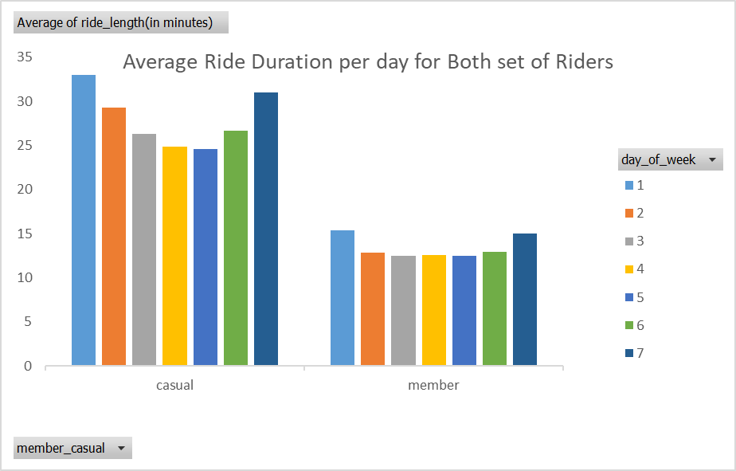
Average Duration of Rides per Day of week
Casual Riders take long duration Rides than Member Riders may be for good cardio, long distance cycling, fun etc.

Slide 10
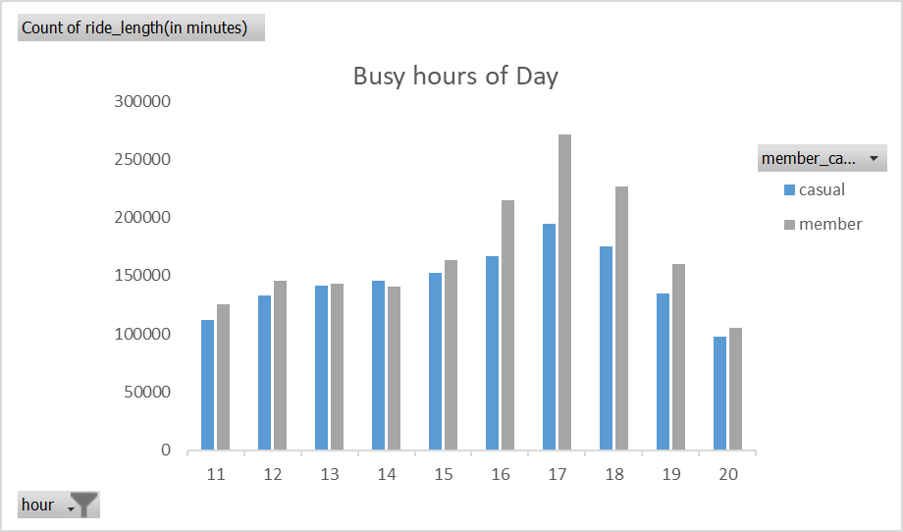
Busy hours of Day
Both set of riders use bikes most during 4pm -6pm which, maybe time to come back from work to home.

Slide 11
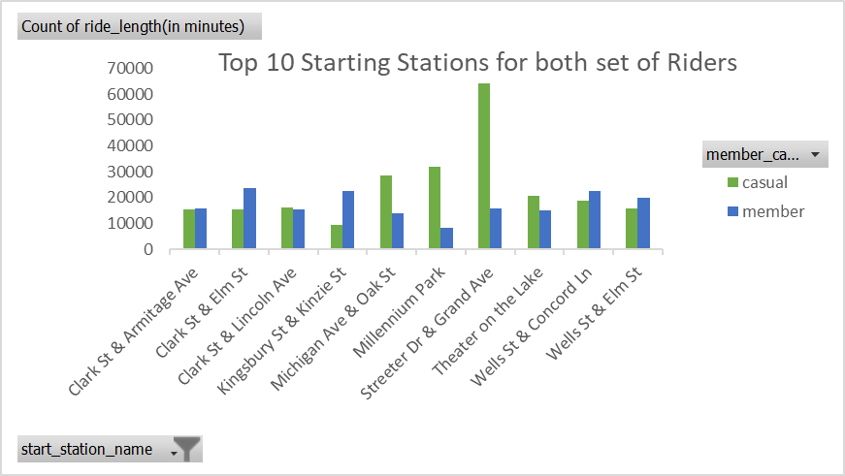
Top most Start stations where number of rides is High
Streeter Dr & Grand Ave is the start station for most of the casual riders.
Member riders start mostly at Clark St & Elm St.

Slide 12
Important points from analysis
Casual riders use bikes more on the weekends and they also use it for Longer durations than member riders. However, Member riders are more consistent with using bikes all over the week.
Seasonal changes also play a key role in rides with a significant decrease in casual rides taken during cold seasons. Member riders use bikes all through year with decrease in January and February.
Both sets tend to use bikes during working hours 11am-6pm with Rush hour between 4pm -6pm.

Slide 13
My Three Recommendations
Since frequency of casual rides is high on weekends, Hence special weekend plans can be introduced in annual memberships to lure more casual riders in to taking annual membership.
Casual members tend to take longer duration trips. Special plans or passes can be introduced at rates that will be attractive.
Introduce special annual membership plans with focus on Rush hours from 4pm -6pm. Offer discounted rates/special rates so that more casual members can sign up for annual membership.

Slide 14

Thank you from Cyclistic Bike-Share Data Analytics Team
Presenter -Aqil Rashid Khan

